Slide 1
Feature engineering
Using Snowflake and Feature Stores
- Anish Rout
Github : https://github.com/anish3004/model-train

Slide 2
Introduction to Feature Engineering
Feature engineering is the process of using domain knowledge to extract features (input variables) from raw data that make machine learning algorithms work more effectively.
Importance :
Enhances model accuracy.
Reduces overfitting.
Makes models generalize better.
Allows incorporation of domain knowledge.
Feature Engineering Techniques :
Normalization : Transforms features to a common scale without distorting differences in the ranges.
Min-Max Scaling: Scales data between 0 and 1.
Standardization (Z-score): Converts data to have mean = 0 and std = 1.
Use case: Required for algorithms like KNN, SVM, Logistic Regression.
Encoding Categorical Variables : Converts non-numeric (categorical) data into a numeric format.
One-Hot Encoding: Creates binary columns (used for nominal categories).
Label Encoding: Converts categories into numeric labels (for ordinal data).
Use case: Needed for ML algorithms that require numeric input.
Time-Based Aggregations : It involves grouping and summarizing data over specific time windows to extract temporal patterns or trends.
Use cases : Behaviour Tracking, Churn Prediction, Sales Forecasting, Anomaly Detection.

Slide 3
Using Snowflake for Data Storage & Processing
Q. How Snowflake is used for storing structured and semi-structured data ?
Ans - Structured Data :
Snowflake stores structured data (e.g., tables with defined columns and types like INT, VARCHAR, DATE) in a relational format.
It uses a columnar storage architecture, which improves query performance for analytical workloads.
Example sources: sales data, user profiles, transactions.
Unstructured Data :
Snowflake natively supports semi-structured data formats like: JSON, AVRO, ORDC, PARQUET, XML.
One can load these formats directly into Snowflake tables using the VARIANT data type.

Slide 4
SQL queries that extract and preprocess data in Snowflake. :
Scenario : You have a table called e-commerce_events with the following columns:
event_id, user_type, event_type (e.g., 'purchase', 'click', 'view’), event_time, amount (only for purchase events)
You want to extract features like:
Total purchase count per user, Total and average amount spent, Last purchase date.
1. Extract Purchase Events :
SELECT
user_id,
event_time,
amount
FROM ecommerce_events
WHERE event_type = 'purchase’;
2. Preprocess: Aggregate Features Per User :
SELECT
user_id,
COUNT(*) AS total_purchases,
SUM(amount) AS total_spent,
AVG(amount) AS avg_purchase_value,
MAX(DATE(event_time)) AS last_purchase_date
FROM ecommerce_events
WHERE event_type = 'purchase’
GROUP BY user_id;

Slide 5
Time-Based Aggregation: Monthly Spending per User :
SELECT
user_id,
TO_CHAR(DATE_TRUNC('month', event_time), 'YYYY-MM') AS month,
COUNT(*) AS monthly_purchases,
SUM(amount) AS monthly_spent
FROM ecommerce_events
WHERE event_type = 'purchase’
GROUP BY user_id, DATE_TRUNC('month', event_time)
ORDER BY user_id, month;
Preprocessing with NULL Handling :
SELECT
user_id,
COUNT(*) AS total_purchases,
COALESCE(SUM(amount), 0) AS total_spent,
COALESCE(AVG(amount), 0) AS avg_purchase_value
FROM ecommerce_events
WHERE event_type = 'purchase’
GROUP BY user_id;

Slide 6
Snowflake Integration with ML pipelines : Snowflake serves as a centralized, scalable data platform that integrates seamlessly into machine learning (ML) workflows for both batch and real-time use cases.
Data Storage for ML : Stores large volumes of structured and semi-structured data (e.g., user behavior, transactions, logs).
Acts as the single source of truth for raw and engineered features.
Feature Engineering Inside Snowflake :
Use SQL or Snowpark (Python/Scala) to perform data transformation and feature engineering directly in Snowflake.
Eliminates the need to move data for preprocessing.
Example: Generate customer-level aggregates like total spend, average session duration, etc.
Data Extraction for ML Models :
ML tools like scikit-learn, XGBoost, TensorFlow, or cloud platforms can extract features via:
ODBC/JDBC
Snowflake Connector for Python
Snowpark DataFrames
External Tables for S3

Slide 7
Integration with ML Platforms :
Snowflake can be connected to ML tools and pipelines on:
AWS SageMaker
Databricks
Google Vertex AI
Supports direct querying from notebooks or automated pipelines.
Storing & Serving Features :
Use Snowflake as a feature store:
Store pre-engineered features in a user_features table.
Provide consistent features during both training and inference.
MLOps Support :
Snowflake integrates with orchestration tools like Airflow, DBT, and KubeFlow for scheduling ETL/feature jobs.
Supports versioning, access control, and auditing for ML data pipelines.

Slide 8
Feature Store Concepts
A Feature Store is a centralized system for storing, managing, and serving features used in machine learning models.
It acts as a bridge between data engineering and machine learning, making features consistently available for both training and real-time inference.
Key Functions:
Feature Storage – Stores pre-processed features in an organized way.
Feature Serving – Provides features to models during both training and prediction.
Feature Reuse – Enables reuse of features across different ML models/projects.
Consistency – Ensures the same logic is used for both training and inference.
Monitoring & Versioning – Tracks data drift, freshness, and changes in features.

Slide 9
Why Is It Needed?
Consistency Between Training and Inference :
One of the most common issues in ML pipelines is data drift due to different code or logic being used in training vs. real-time prediction.
A feature store ensures that the same feature definitions are used during both model training and inference, reducing the risk of inconsistent results or model degradation.
Reusability and Collaboration :
Without a feature store, data scientists often create duplicate versions of the same features.
A feature store promotes reusability by allowing features to be defined once and shared across teams and projects.
This saves time, improves productivity, and ensures standardization.
Operational Efficiency :
Feature engineering is often a time-consuming step in the ML lifecycle.
A to support low-latency feature retrieval, making them essential for online prediction systems.
feature store enables the storage of precomputed features, which can be accessed quickly during model training or prediction, leading to faster development and deployment cycles.
Monitoring and Governance :
Feature stores support metadata tracking, versioning, and freshness monitoring.
This is critical for auditing, reproducibility, and regulatory compliance in production ML systems.
Real-time Feature Serving :
In modern applications like fraud detection or recommendation engines, models require features to be available in real-time.
Feature stores are designed to support low-latency feature retrieval, making them essential for online prediction systems.

Slide 10
Compare different feature stores :
Feature Store | AWS SageMaker Feature Store | Snowflake Feature Store | Databricks Feature Store
Provider | Amazon Web Services | Snowflake | Databricks
Primary Storage | Amazon S3 / DynamoDB | Snowflake Tables (internal DB) | Delta Lake (on cloud storage)
Integration with ML Tools | Tight with SageMaker pipelines | Integrates with Snowpark, Python | Native to Databricks ML + notebooks
Real-time Feature Serving | Yes (via online store - DynamoDB) | Limited (batch-focused, real-time via workarounds) | Yes
Batch Feature Access | Yes | Yes | Yes
Feature Monitoring / Metadata | Integrated with SageMaker | Basic metadata, manual tracking | Automatic metadata & lineage
Versioning Support | Yes | Manual versioning | Yes (built-in with Delta tables)
Use Case Fit | Production-scale real-time apps | Enterprise BI + ML data unification | ML experimentation + production
Pricing | Pay-per-use (based on storage + requests) | Based on Snowflake compute/storage | Based on Databricks usage

Slide 11
Implementing Feature Engineering with Snowflake & Feature Store
Extract: Fetch Raw Data from Snowflake :
SELECT
user_id,
event_time,
amount
FROM ecommerce_events
WHERE event_type = 'purchase’;
/* This pulls raw purchase data for feature creation. */
Transform: Feature Engineering (Aggregations, Encoding, etc.) :
Once the raw data is fetched, you apply feature engineering techniques like:
Aggregations: Total purchases, total amount spent, last purchase date.
Encoding: Convert categories into numeric values if needed.
Time-Based Features: Monthly spending, days since last login, etc.
Monthly spending, days since last login, etc.

Slide 12
Example in Python:
import pandas as pd
df = pd.read_csv("raw_data.csv")
features = df.groupby("user_id").agg(
total_spent=("amount", "sum"),
avg_spent=("amount", "mean"),
transactions=("amount", "count")
).reset_index()
These engineered features are now ready to be stored.
Load into Feature Store : The engineered features are loaded back into Snowflake (used here as the Feature Store), or pushed to a cloud-based store like SageMaker or Databricks.
Example SQL to Store in Snowflake:
CREATE OR REPLACE TABLE user_features (
user_id STRING PRIMARY KEY,
total_spent FLOAT,
avg_spent FLOAT,
transactions INT
);

Slide 13
INSERT INTO user_features VALUES
('U001', 250.0, 125.0, 2),
('U002', 300.0, 100.0, 3);
Access for ML : Retrieve Features for Model Training
ML models access features using:
SQL Queries (for batch access)
Snowflake Python Connector
DataFrames (Snowpark or Pandas)
Connected platforms like SageMaker, Databricks, Vertex AI, etc.
Example in Python :
from snowflake.connector import connect
import pandas as pd
conn = connect(...)
cursor = conn.cursor()
cursor.execute("SELECT * FROM user_features")
df = pd.DataFrame(cursor.fetchall(), columns=["user_id", "total_spent", "avg_spent", "transactions"])
This feature DataFrame can now be used for training ML models like logistic regression, random forests, etc.

Slide 14
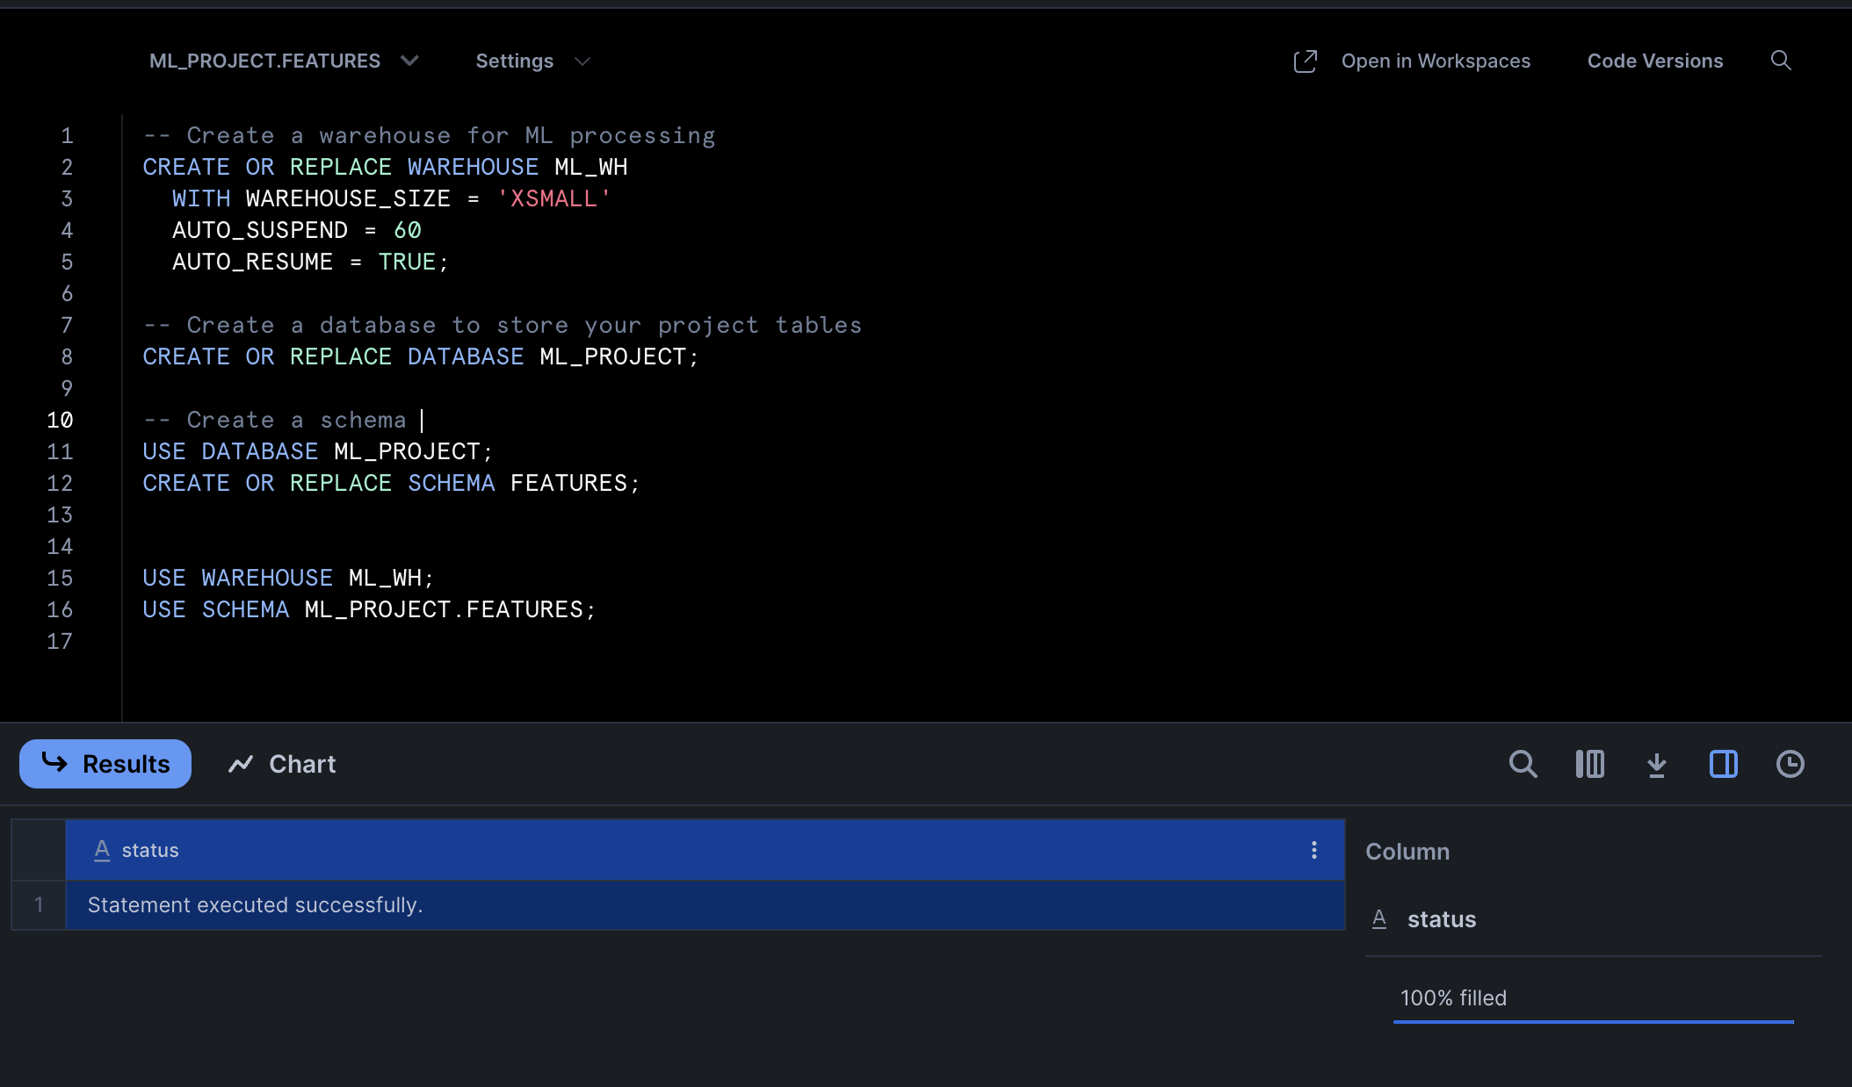
Practical Task:
Snowflake Configuration for ML Project: Warehouse, Database, and Schema
-- Create a warehouse for ML processing
CREATE OR REPLACE WAREHOUSE ML_WH
WITH WAREHOUSE_SIZE = 'XSMALL'
AUTO_SUSPEND = 60
AUTO_RESUME = TRUE;
-- Create a database to store your project tables
CREATE OR REPLACE DATABASE ML_PROJECT;
-- Create a schema within that database
USE DATABASE ML_PROJECT;
CREATE OR REPLACE SCHEMA FEATURES;
USE WAREHOUSE ML_WH;
USE SCHEMA ML_PROJECT.FEATURES;

Slide 15
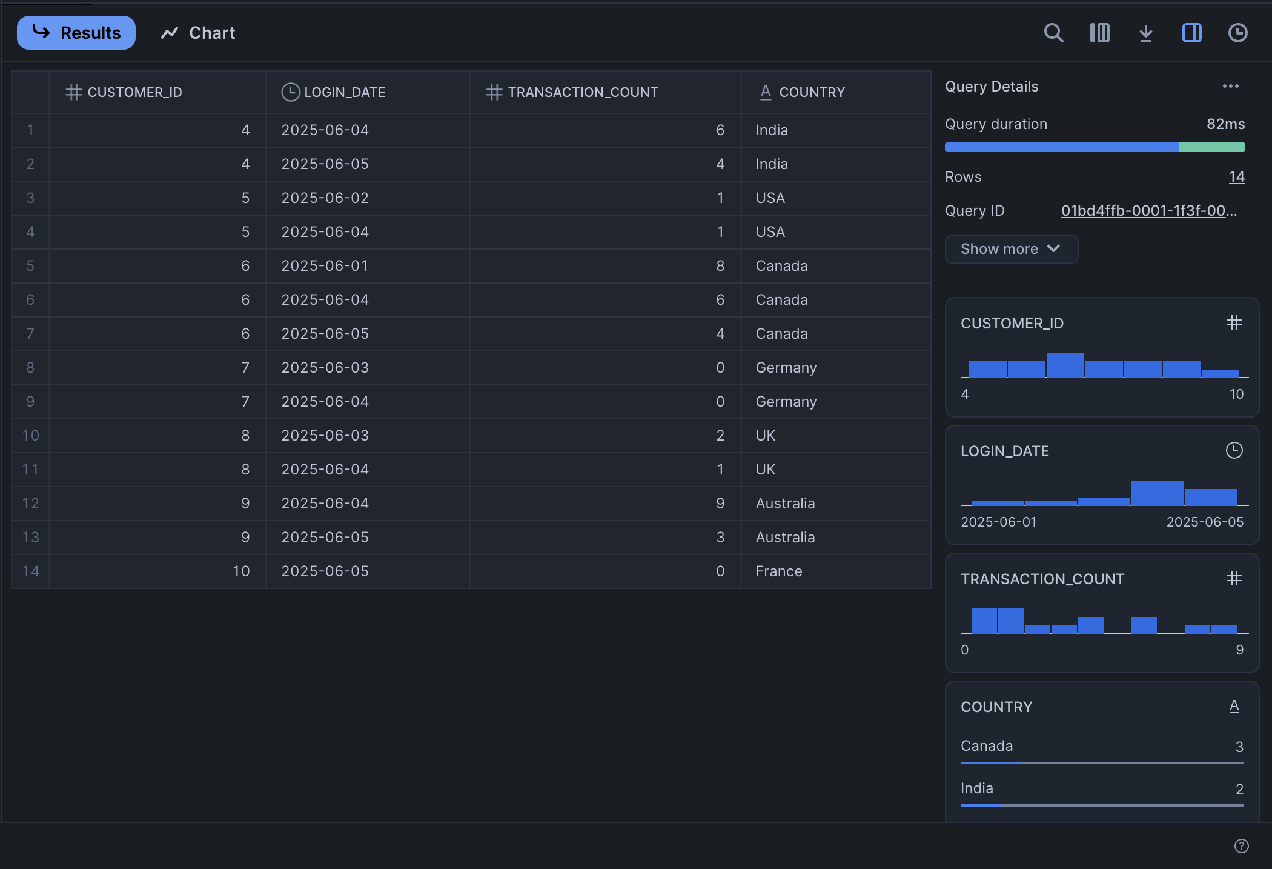
SAMPLE DATA :
USE DATABASE ML_PROJECT;
USE SCHEMA FEATURES;
CREATE OR REPLACE TABLE CUSTOMER_ACTIVITY (
CUSTOMER_ID INT,
LOGIN_DATE DATE,
TRANSACTION_COUNT INT,
COUNTRY STRING
);
INSERT INTO CUSTOMER_ACTIVITY (CUSTOMER_ID, LOGIN_DATE, TRANSACTION_COUNT, COUNTRY) VALUES
(4, '2025-06-04', 6, 'India'),
(4, '2025-06-05', 4, 'India'),
(5, '2025-06-02', 1, 'USA'),
(5, '2025-06-04', 1, 'USA'),
(6, '2025-06-01', 8, 'Canada'),
(6, '2025-06-04', 6, 'Canada'),
(6, '2025-06-05', 4, 'Canada'),
(7, '2025-06-03', 0, 'Germany'),
(7, '2025-06-04', 0, 'Germany'),
(8, '2025-06-03', 2, 'UK'),
(8, '2025-06-04', 1, 'UK'),
(9, '2025-06-04', 9, 'Australia'),
(9, '2025-06-05', 3, 'Australia'),
(10, '2025-06-05', 0, 'France’);
SELECT * FROM CUSTOMER_ACTIVITY;

Slide 16
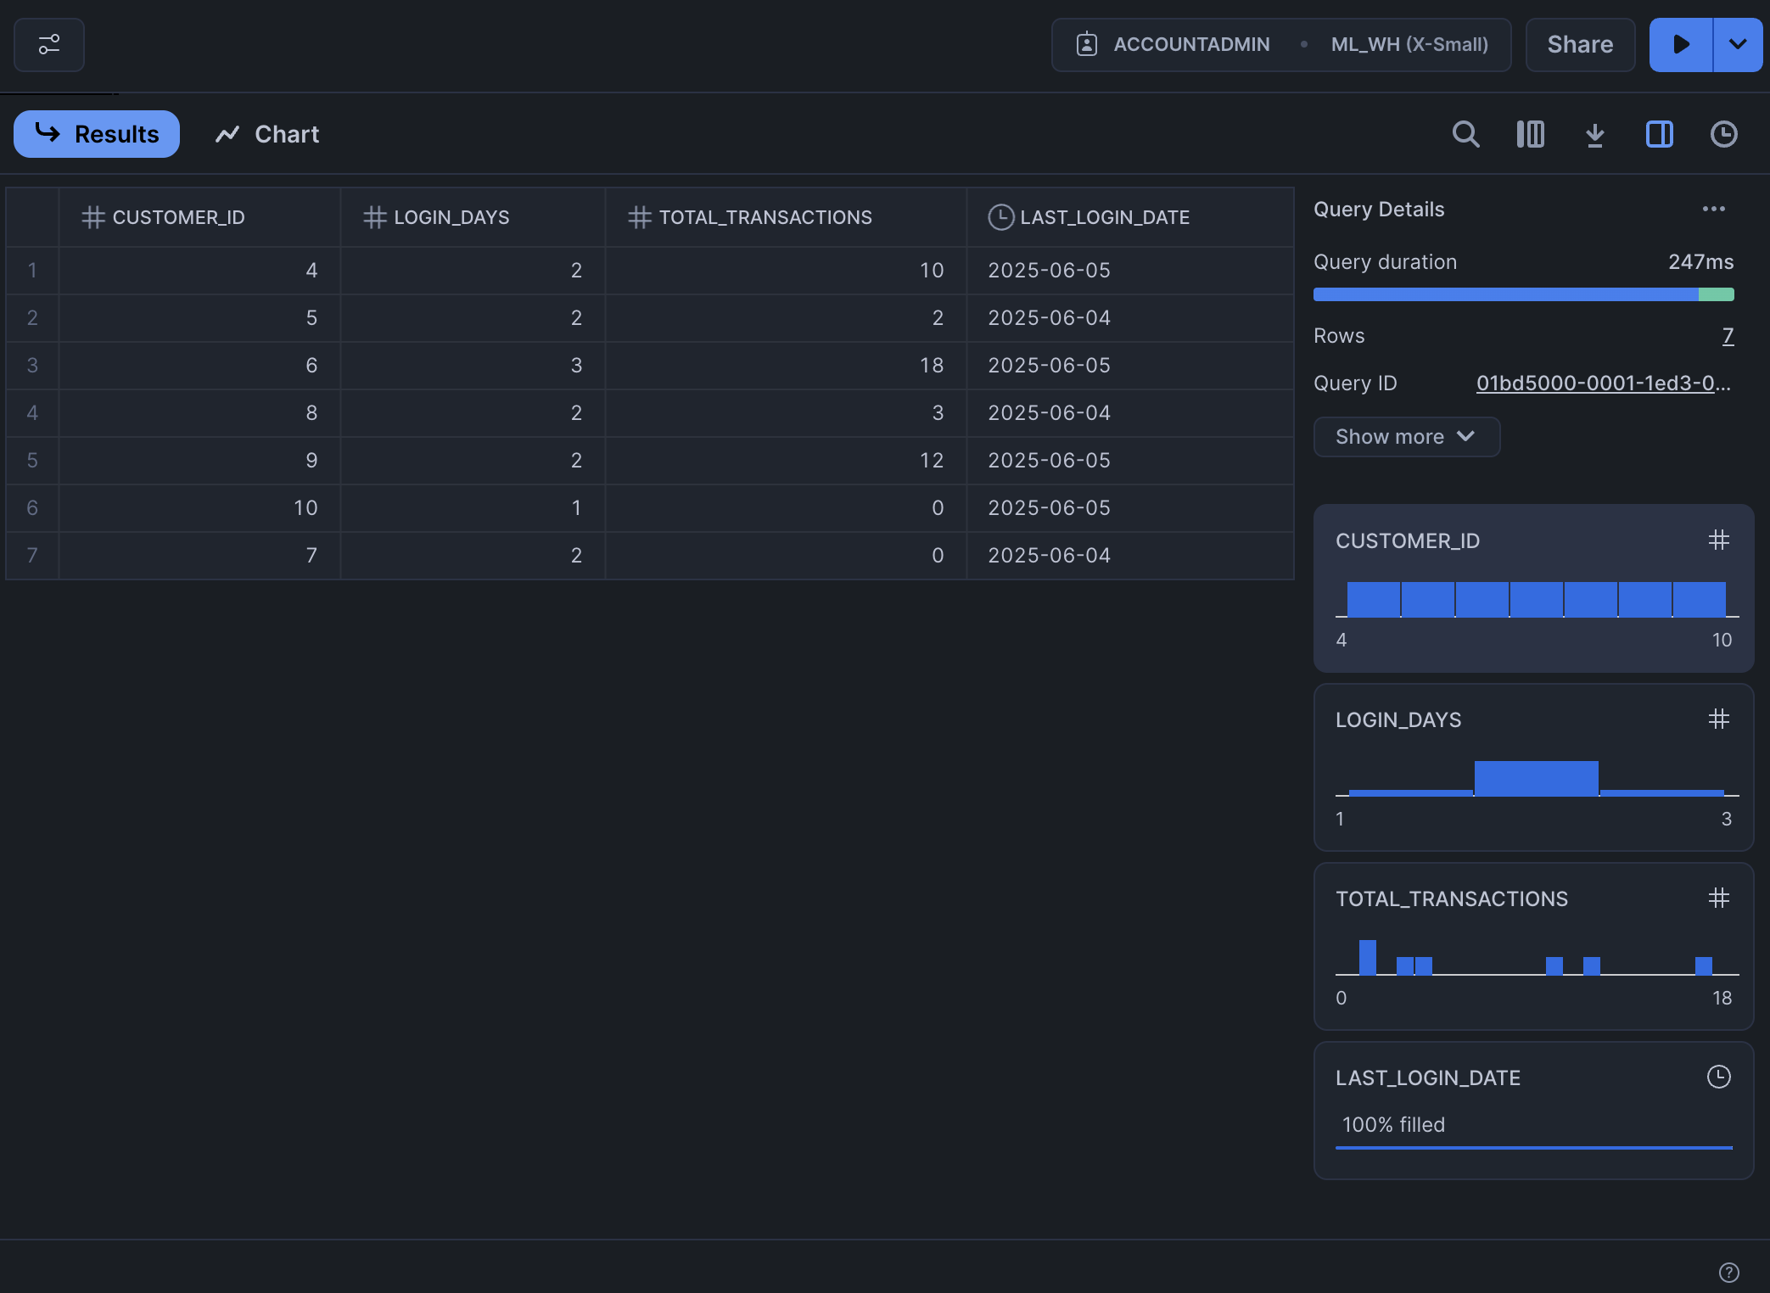
Creating and Storing Engineered Features in Snowflake
USE WAREHOUSE ML_WH;
USE DATABASE ML_PROJECT;
USE SCHEMA FEATURES;
CREATE OR REPLACE TABLE CUSTOMER_FEATURES AS
SELECT
CUSTOMER_ID,
COUNT(*) AS LOGIN_DAYS,
SUM(TRANSACTION_COUNT) AS TOTAL_TRANSACTIONS,
MAX(LOGIN_DATE) AS LAST_LOGIN_DATE
FROM
CUSTOMER_ACTIVITY
GROUP BY
CUSTOMER_ID;
SELECT * FROM CUSTOMER_FEATURES;

Slide 17
Establishing a Snowflake Connection in Python
import snowflake.connector
def get_connection():
conn = snowflake.connector.connect(
user='Anish3004’,
password=‘My_Password',
account='LTSFLEG-MO32405’,
warehouse='ML_WH’,
database='ML_PROJECT',
schema='FEATURES'
)
return conn
EXPLANATION :
Secure connection to Snowflake using Python
Uses credentials and metadata (warehouse, DB, schema)
Enables feature retrieval directly from Snowflake

Slide 18
Fetching Features from Snowflake into Python
print("🚀 Script started") import pandas as pd -
from snowflake_config import get_connection try:
conn = get_connection()
query = "SELECT * FROM CUSTOMER_FEATURES;"
df = pd.read_sql(query, conn)
conn.close()
print("Connected and data fetched.")
print("Number of rows:", len(df))
print(df.head())
except Exception as e:
print(" An error occurred:", e)
EXPLANATION :
Uses pandas.read_sql() to run a query.
Retrieves engineered features into a DataFrame.
Handles connection safely with try-except block.

Slide 19
Training and Evaluating ML Model on Engineered Feature
import pandas as pd
from sklearn.model_selection import train_test_split
from sklearn.ensemble import RandomForestClassifier
from sklearn.metrics import classification_report
from snowflake_config import get_connection
# Load features from Snowflake
conn = get_connection()
query = "SELECT * FROM CUSTOMER_FEATURES;"
df = pd.read_sql(query, conn)
conn.close()
# Create target label (active = 1, inactive = 0)
df['IS_ACTIVE'] = ((df['LOGIN_DAYS'] >= 3) & (df['TOTAL_TRANSACTIONS'] >= 10)).astype(int)
# Drop non-numeric columns
df['LAST_LOGIN_DATE'] = pd.to_datetime(df['LAST_LOGIN_DATE'])
df['DAYS_SINCE_LAST_LOGIN'] = (pd.Timestamp.today() - df['LAST_LOGIN_DATE']).dt.days
df = df.drop(columns=['CUSTOMER_ID', 'LAST_LOGIN_DATE'])
EXPLANATION :
Creates a binary label IS_ACTIVE based on login and transaction thresholds
Calculates DAYS_SINCE_LAST_LOGIN as a new numerical feature
Trains a RandomForestClassifier on engineered features
Evaluates performance using classification_report

Slide 20
# Split dataset
X = df.drop(columns='IS_ACTIVE')
y = df['IS_ACTIVE']
X_train, X_test, y_train, y_test = train_test_split(X, y, test_size=0.3, random_state=42)
# Train Random Forest model
model = RandomForestClassifier(n_estimators=100, random_state=42)
model.fit(X_train, y_train)
# Evaluate model
y_pred = model.predict(X_test)
print(" Classification Report:\n")
print(classification_report(y_test, y_pred))

Slide 21
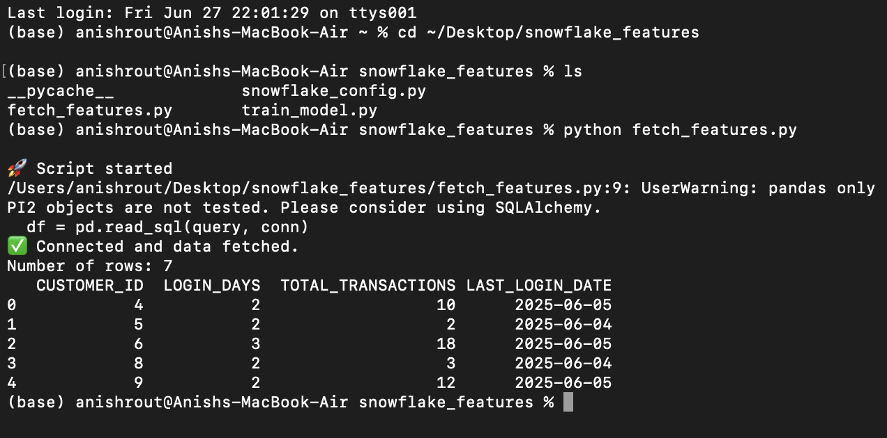
OUTPUT
Run on terminal :
cd ~/Desktop/snowflake_features -> ls -> python fetch_features.py
This will connect to Snowflake and print the contents of CUSTOMER_FEATURES.

Slide 22
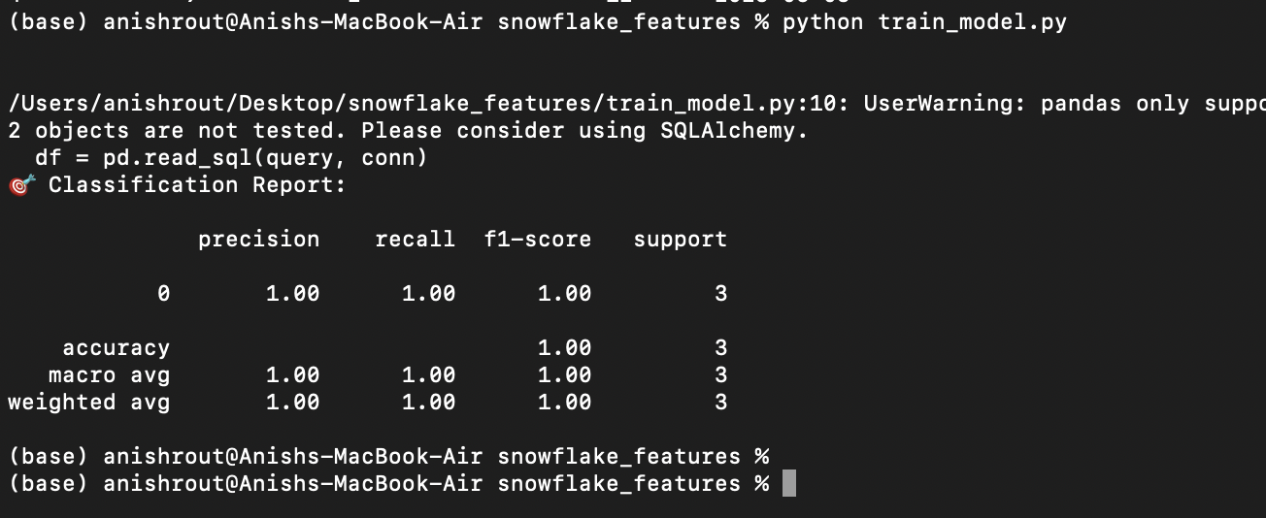
To Run the Model Training Script :
Run Python train_model.py on terminal.
Metric Class 0 (IS_ACTIVE = 0)
Precision 1.00 — All predicted "inactive" customers were actually inactive.
Recall 1.00 — The model found all actual inactive customers.
F1-Score 1.00 — Harmonic mean of precision and recall.
Support 3 — There were 3 samples of inactive customers in the test set.
Accuracy: 1.00 → All predictions were correct (100% accuracy).
Macro Avg: Simple average of metrics across all classes. Since there's only 1 class shown (0), it's the same as above.
Weighted Avg: Weighted by the number of samples per class. Again, same because all were of class 0

